Slide 1

Capstone Project
ML Foundation Course
Name: Januka Dharmapriya
Registration Number: 266
Email: janukad@janashakthi.com

Slide 2
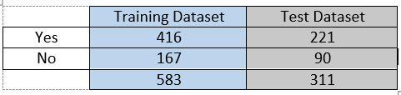
Data Set
This dataset has 894 samples and the Training Dataset consists of 583 samples and the Testing Dataset consists of 311 samples.
The Training Dataset set contains 416 liver patient records and 167 non-liver patient records.
The given dataset has only two (2) classes as “Yes” for liver patient and “No” for non-liver patient.
There are eleven (11) attributes available in the dataset and ‘Gender’ and ‘Class’ attributes are nominal attribute while all the others are numerical attributes.
Class distribution of the Training and the Test datasets are as follows.

Slide 3
Training Process
The training process was completed by using the “Keras” from TensorFlow while following steps listed in below.
Loading the Training and Testing datasets (Using Python “Pandas” framework).
Describing Training dataset.
Describing Testing dataset.
Visualizations of the Training and Testing datasets.
Data pre-processing.
Feature selections for the training process.
Building the model (Using “Keras” from TensorFlow).
Training the model.
Evaluating the built-in model.

Slide 4
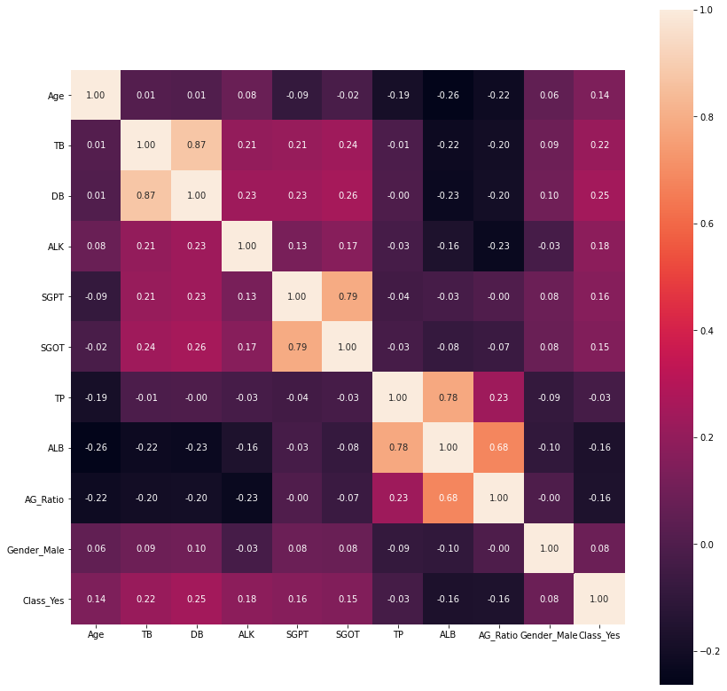
Correlation between the attributes of the Training dataset

Slide 5
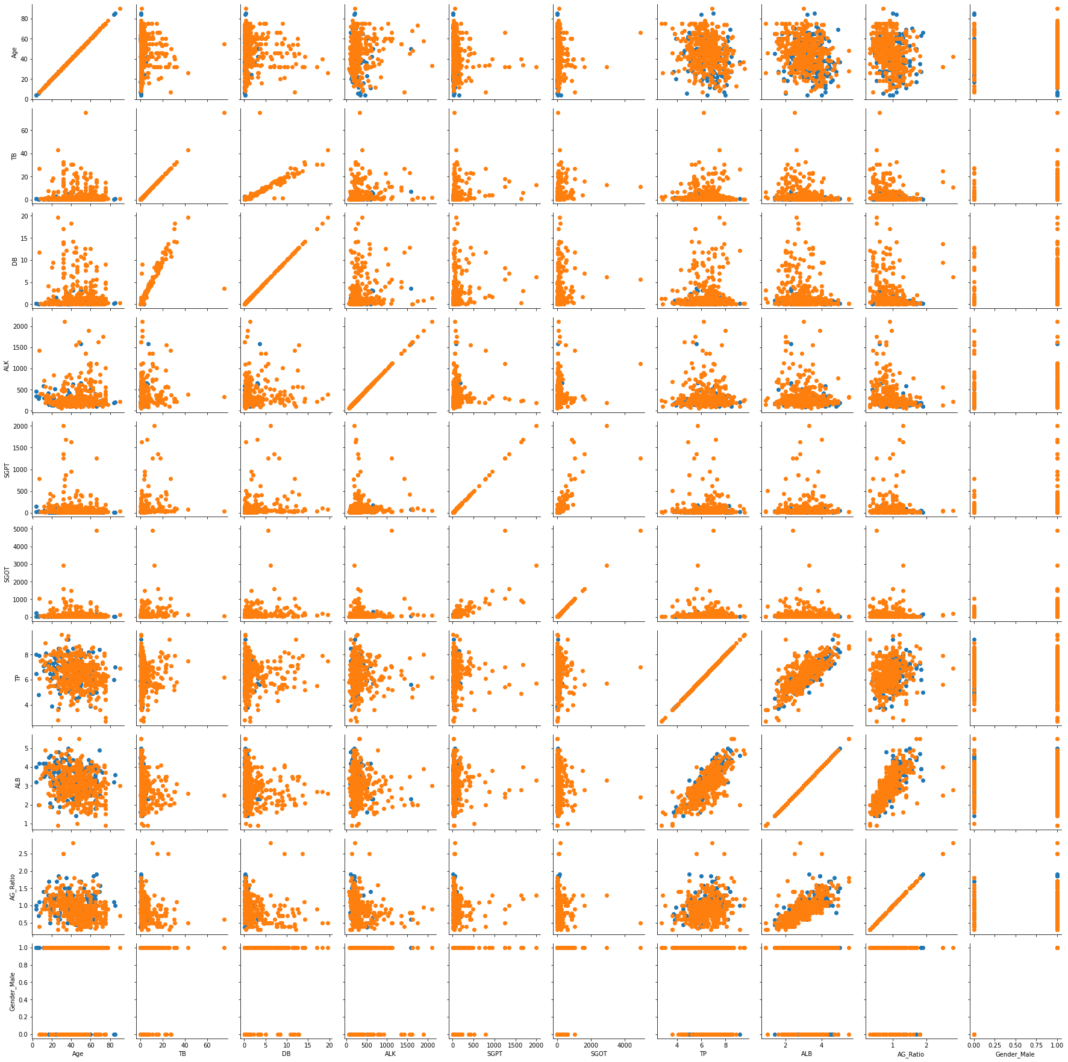
Correlation between the attributes of the Training dataset

Slide 6
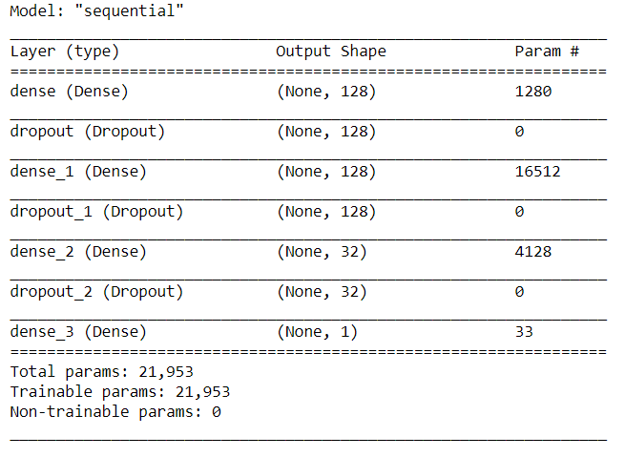
Building the Model
For building the supervised learning model, I have used Keras from the TensorFlow.
Keras act as a wrapper for the TensorFlow. It can easily be used for building machine learning models with having only a few lines of code.
Since the planned model has exactly one input tensor and one output tensor, I have used “Sequential model” in Keras for this step.
Keras Model summary:

Slide 7
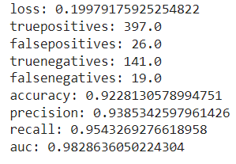
Building the Model
For building the supervised learning model, I have used Keras from the TensorFlow.
Keras act as a wrapper for the TensorFlow. It can easily be used for building machine learning models with having only a few lines of code.
Since the planned model has exactly one input tensor and one output tensor, I have used “Sequential model” in Keras for this step.
Evaluation metric values for the model:
Keras Model summary:

Slide 8
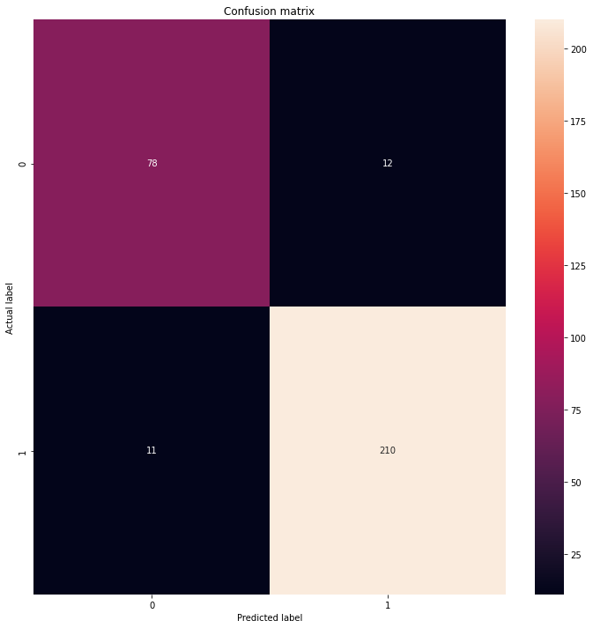
Confusion matrix for the Test dataset
Correctly identified negative patients (True Negatives): 78
Incorrectly identified negative patients (False Positives): 12
Incorrectly identified positive patients:(False Negatives): 11
Correctly identified positive patients (True Positives): 210
Total Positive patients: 221
Total Negative Patients: 90

